Slide 1

Project 3
Books Review Insights Dashboard

Slide 2

Project objective:
Analyzing and Visualizing popularity of different Authors based on User ratings of Books

Slide 3
Book Reviews and Ratings
A good book review includes a definitive opinion(mostly a Rating on a scale of 0-10), shares your own personal experience, and offers a recommendation on what type of person would like the book
How does it help ?
Decision-Making
Book reviews help readers make informed decisions about which books to read. Reviews provide insights into the book's quality, style, themes, and whether it aligns with the reader's preferences
Summary
A review gives the reader a concise summary of the content. This includes a relevant description of the topic as well as its overall perspective, argument, or purpose.
Critical Assessment
A review offers a critical assessment of the content.This involves users reactions to the work under review: what strikes you as noteworthy, whether or not it was effective or persuasive, and how it enhanced your understanding of the issues at hand.

Slide 4
DataSet
3 CSVs - Users, Ratings, Books
Used GeoAPI to get coordinates for each Location
Merged dataset using MongoDB for Analysis
CSV | Columns
Users | UserID, Location Name
Ratings | UserID, ISBN, Book-Rating
Books | ISBN, Book-Title, Book-Author, Year-Of-Publication, Publisher

Slide 5
Understanding the Project Flow
Step 1 : DB Setup
Step 2 : Run the app.py
Step 3 : Interactive Visualisations
Run Jupyter Notebook DB_setup.ipynb to get the merged data
The following collections will be created: users, geodata, ratings, books
Apart from these 4 main collections, we also have a merged collection that contains all the data
The Flask application has following routes :
/api/v1.0/books
/api/v1.0/users
/api/v1.0/reviews
/api/v1.0/merged
The above routes return the jsonified data
The html page has a Dashboard which displays:
1. Bar Chart (using chartjs)with Average Rating and Reviews Count
2. Quadrant details or High Level Distribution per Author(selected in dropdown)

Slide 6
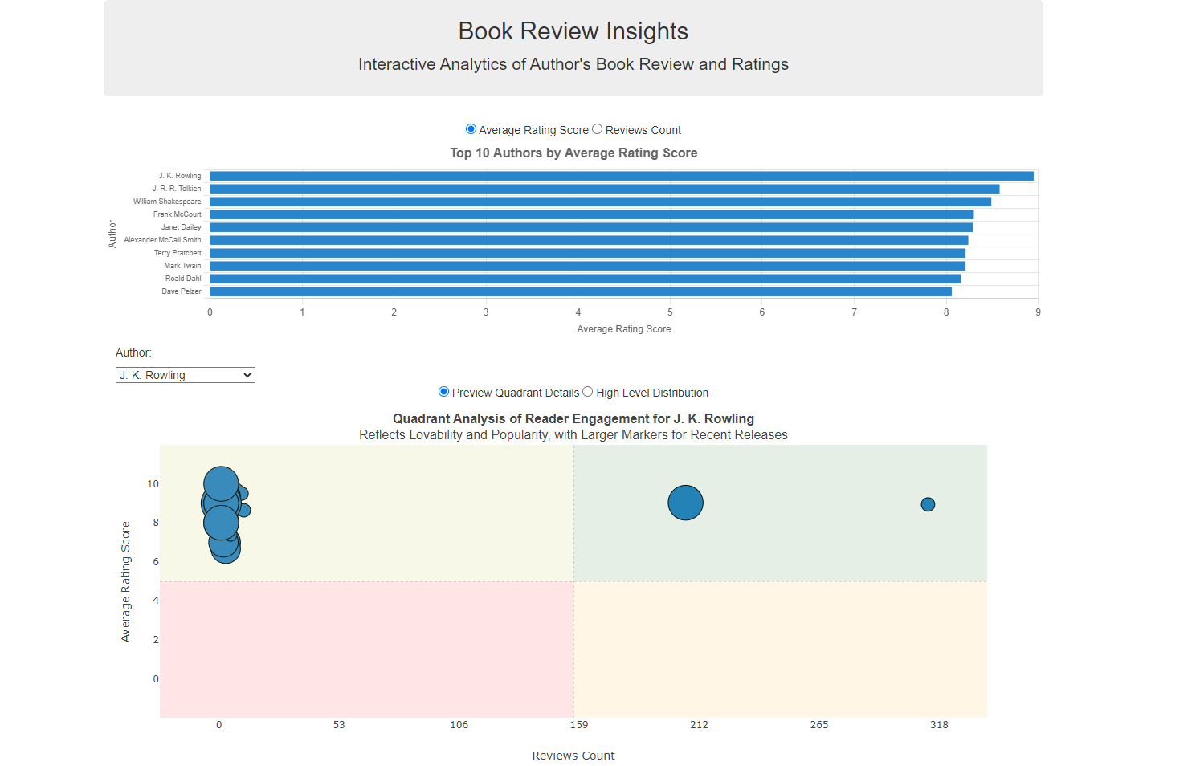
Dashboard Walkthrough(Part 1 of 2)
Default Screen
Bar Chart for Top 10 Authors showing Average Rating Score using chartjs
Quadrant Analysis for each Author selected from the dropdown

Slide 7
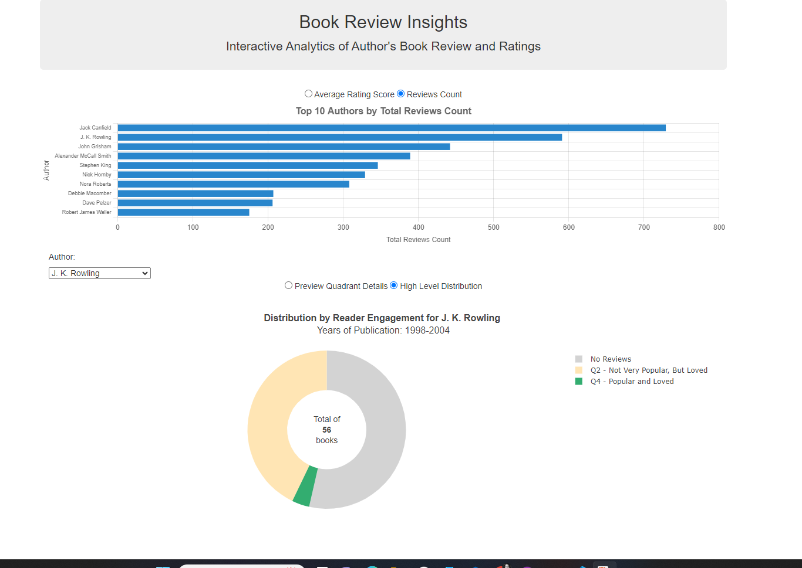
Dashboard Walkthrough(Part 2 of 2)
Screen on changing both Radio buttons
Bar Chart for Top 10 Authors showing Reviews Count using chartjs
Doughnut Chart showing High Level Distribution for each Author

Slide 8
Demo of the Application

Slide 9
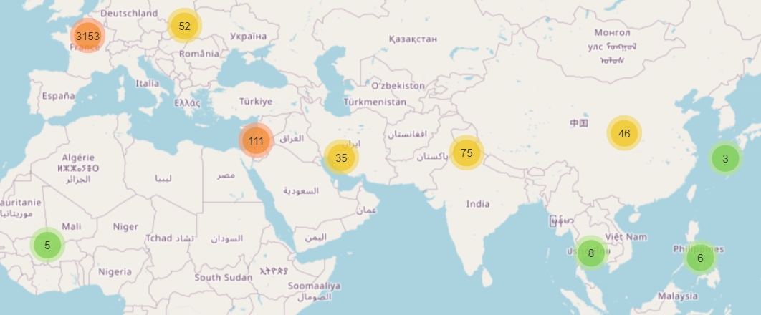
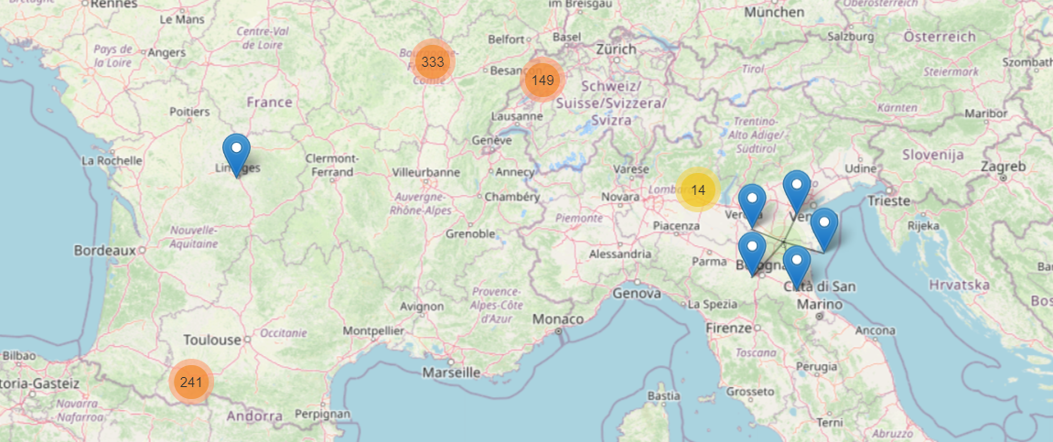
Conclusions: What’s next?
Add interactive map:

Slide 10
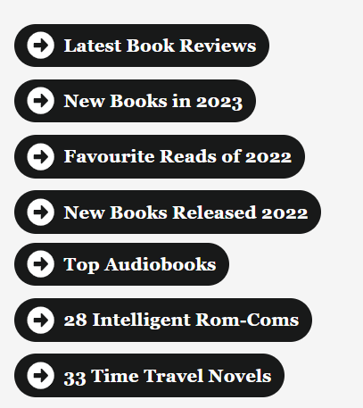
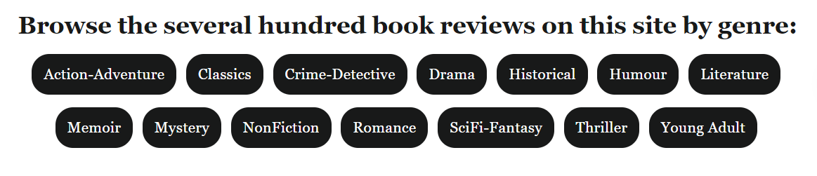
Features to add and improve
Advanced sorting:

Slide 11
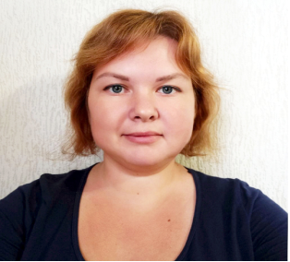



The Team
Daria Z
Neha S
Seeke O.D
Valentyna K

